Slide 1
Spatial Disaggregation Simulation study
Bowen He
Vanderbilt University

Slide 2
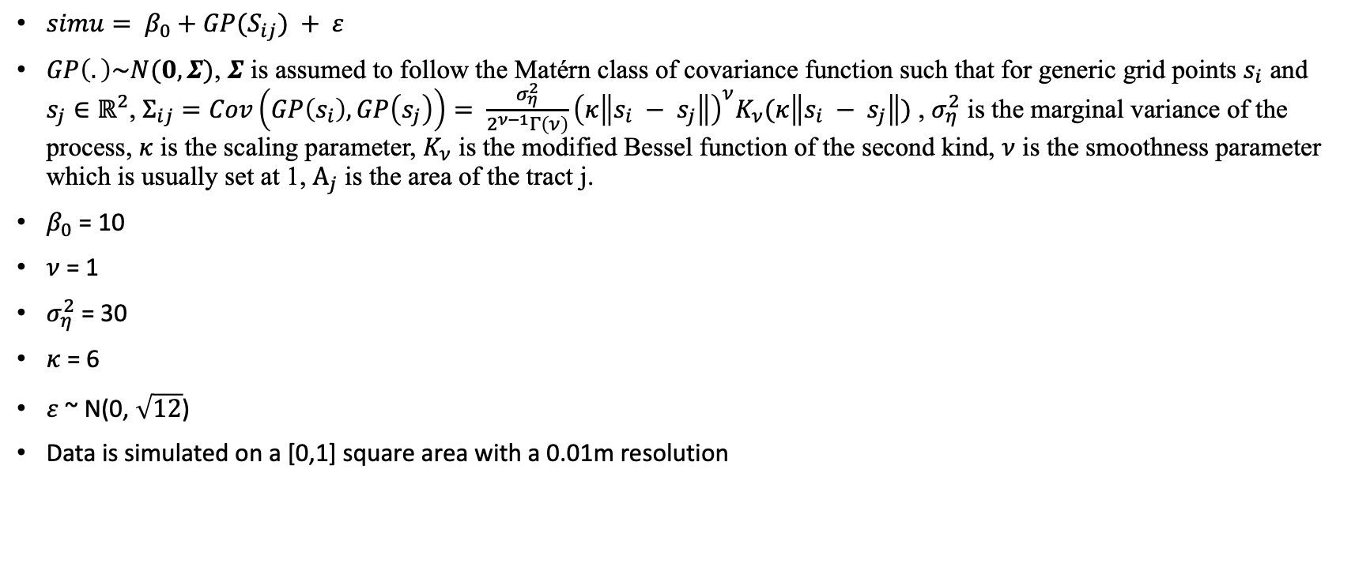
Simulation data
$simu= β_{0}+GP(S_{ij}) + ε$
$GP\left(.\right)\sim N(0, Σ)$, $Σ$ is assumed to follow the Matérn class of covariance function such that for generic grid points $s_{i}$ and $s_{j}∈ℝ^{2}$, $Σ_{ij}=Cov\left(GP\left(s_{i}\right), GP\left(s_{j}\right)\right)= \frac{σ_{η}^{2}}{2^{ν−1}Γ\left(ν\right)}{\left(κ\left\|s_{i} − s_{j}\right\|\right)}^{ν}K_{ν}(κ\left\|s_{i} − s_{j}\right\|)$ , $σ_{η}^{2}$ is the marginal variance of the process, $κ$ is the scaling parameter, $K_{ν}$ is the modified Bessel function of the second kind, $ν$ is the smoothness parameter which is usually set at 1, $Α_{j}$ is the area of the tract j.
$β_{0}$ = 10
$ν$ = 1
$σ_{η}^{2}$ = 30
$κ$ = 6
$ε$ ~ N(0, $\sqrt{12}$)
Data is simulated on a [0,1] square area with a 0.01m resolution

Slide 3
Underlying true simulation grids value (one realization sample)

Slide 4
0.1m resolution area Observation

Slide 5

Posterior mean of the prediction
$β_{0}$ = 11.663
$ε$ ~ N(0, 0.01)
$κ$ = 6.87
$σ_{η}^{2}$ = 22.58
Lm.pred.rmse = 5.69
Sr.pred.rmse = 3.59
Lm.pred.r2 = 0
Sr.pred.r2 = 0.6
Lm.pred.mae = 4.65
Sr.pred.mae = 2.86

Slide 6
0.04m resolution area observation

Slide 7

Posterior mean of the prediction
$β_{0}$ = 11.984
$ε$ ~ N(0, 0.93)
$κ$ = 7.02
$σ_{η}^{2}$ = 20.8
Lm.pred.rmse = 5.69
Sr.pred.rmse = 3.45
Lm.pred.r2 = 0
Sr.pred.r2 = 0.63
Lm.pred.mae = 4.65
Sr.pred.mae = 2.75

Slide 8
0.02m resolution area observation

Slide 9

Posterior mean of the prediction
$β_{0}$ = 11.875
$ε$ ~ N(0, 1.74)
$κ$ = 6.69
$σ_{η}^{2}$ = 22.16
Lm.pred.rmse = 5.69
Sr.pred.rmse = 3.40
Lm.pred.r2 = 0
Sr.pred.r2 = 0.64
Lm.pred.mae = 4.65
Sr.pred.mae = 2.72

Slide 11
Underlying true simulation grids value (one realization sample)

Slide 12
0.1m resolution area observation

Slide 13
Posterior mean and sd of the prediction (0.1m resolution area observation)
RMSE: 3.61
R2: 0.68
MAE: 2.87

Slide 14
0.04m resolution area observation

Slide 15
Posterior mean and sd of the prediction (0.04m resolution area observation)
RMSE: 3.44
R2: 0.71
MAE: 2.73

Slide 16
0.02m resolution area observation

Slide 17
Posterior mean and sd of the prediction (0.02m resolution area observation)
RMSE: 3.4
R2: 0.71
MAE: 2.71

Slide 18
0.0125m resolution area observation

Slide 19
Posterior mean and sd of the prediction (0.0125m resolution area observation)
RMSE: 3.31
R2: 0.73
MAE: 2.64

Slide 20
All grids as observations (0.01m resolution grids)

Slide 21
Posterior mean and sd of
the prediction (original grids observation)
RMSE: 3.37
R2: 0.72
MAE: 2.68

Slide 22
Posterior standard deviation comparison

Slide 23
Model parameter estimation

Slide 24
Prediction residuals and marginal posterior distribution of gaussian variances

Slide 25
Model Evaluation Metrics

Slide 26
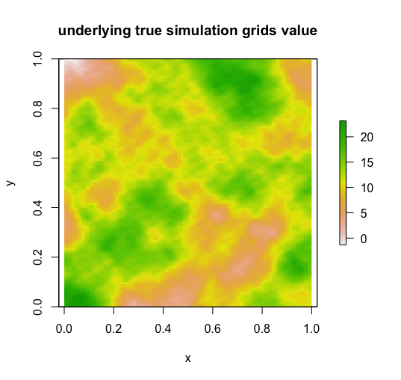
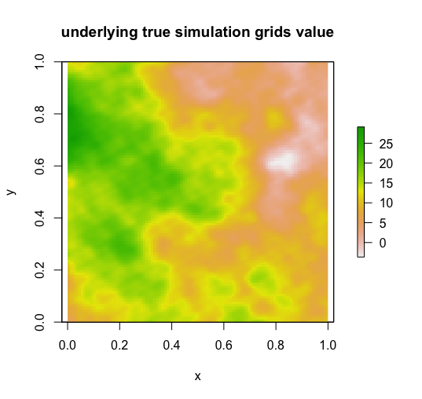
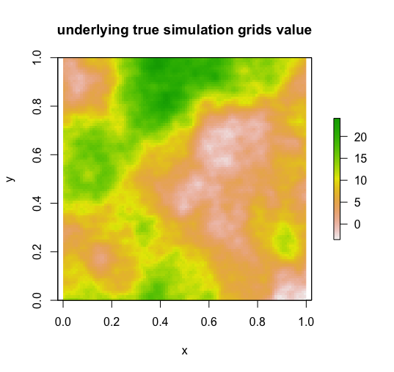
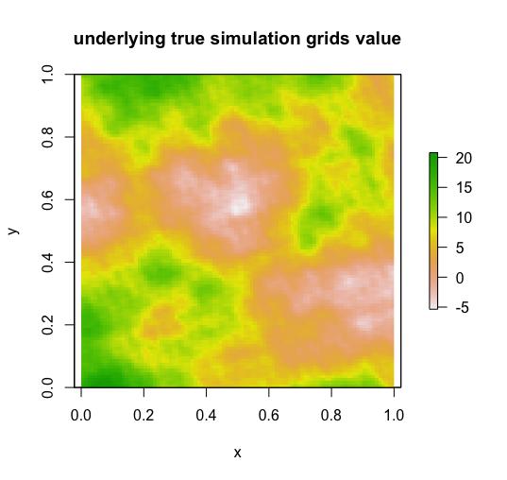
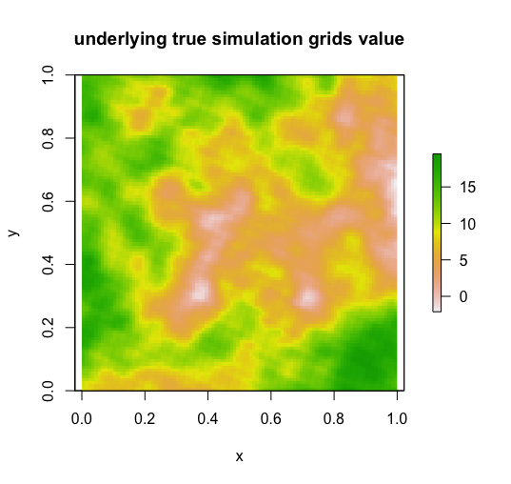
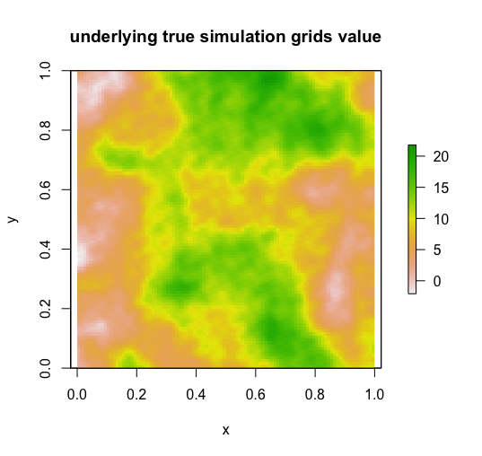
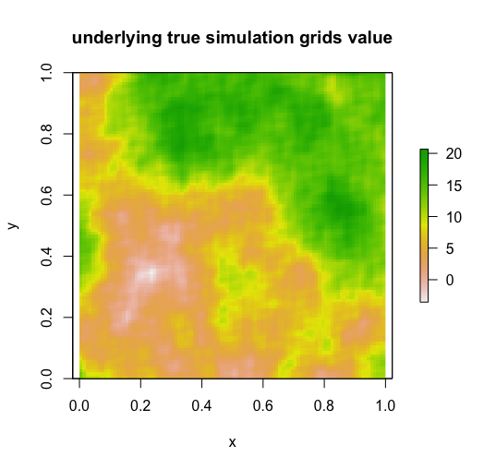
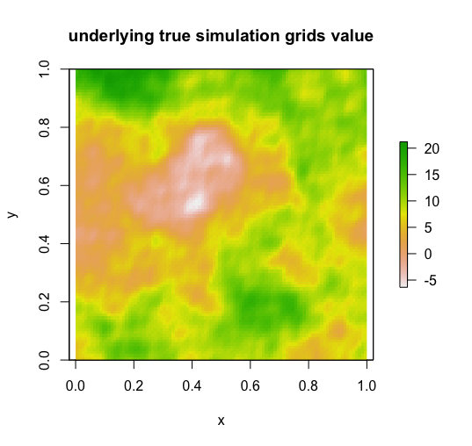
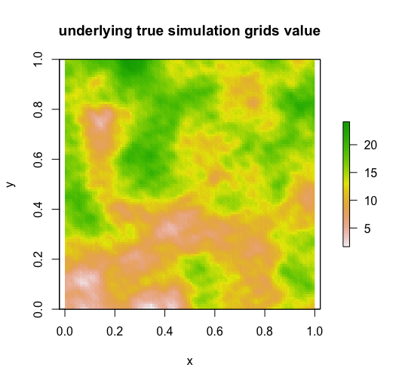
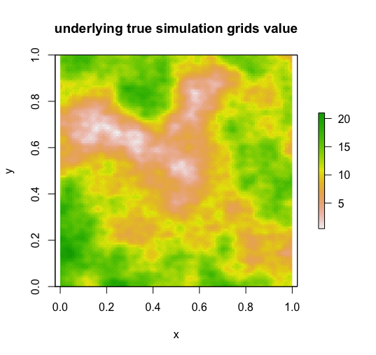
10 realizations experiments
(a)
(b)
(c)
(d)
(e)
(f)
(g)
(h)
(i)
(j)

Slide 27
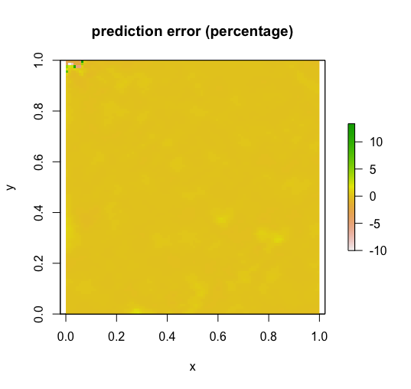
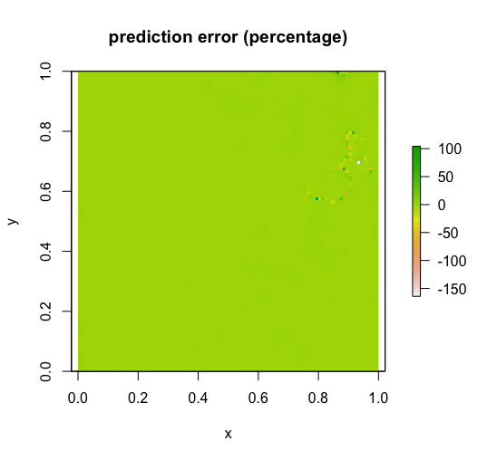
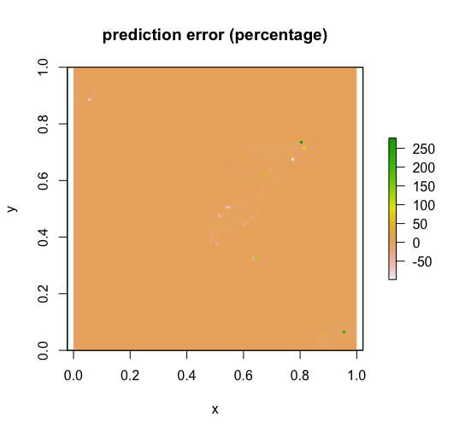
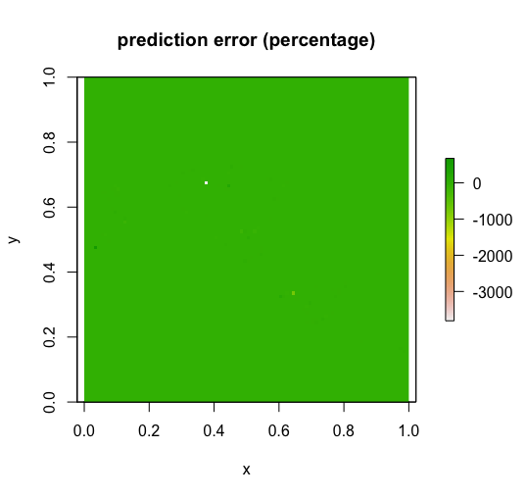
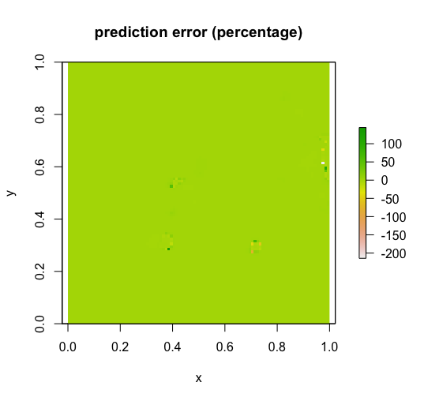
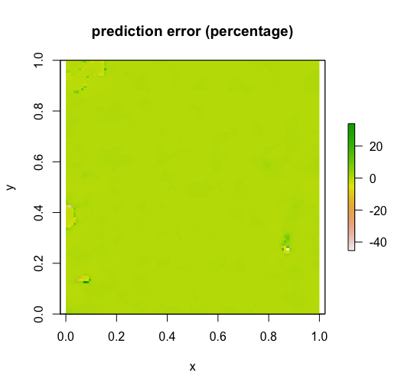
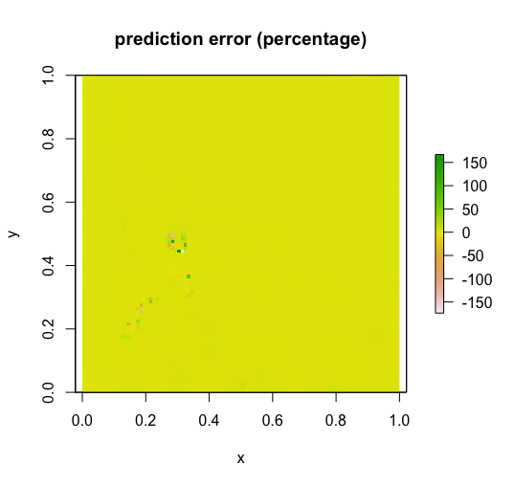
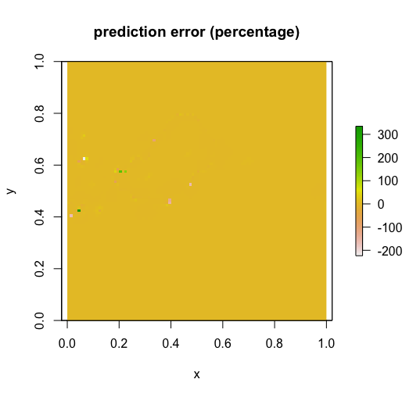
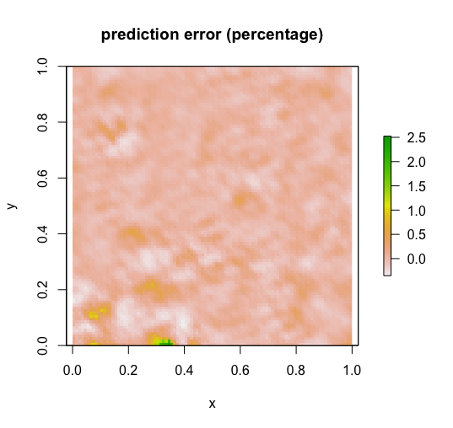
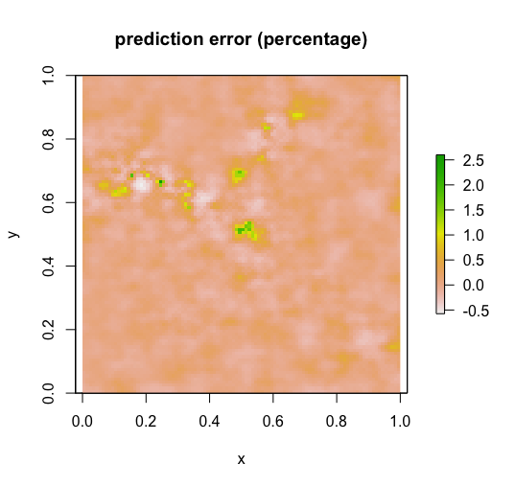
Prediction error (percentage)
(a)
(b)
(c)
(d)
(e)
(f)
(g)
(h)
(i)
(j)

Slide 28
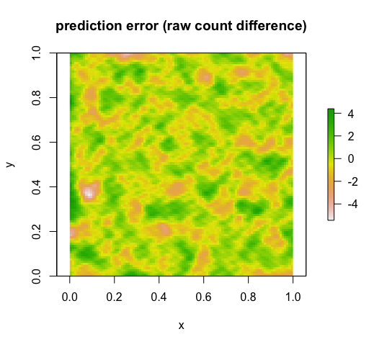
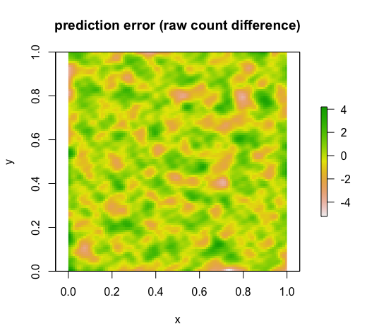
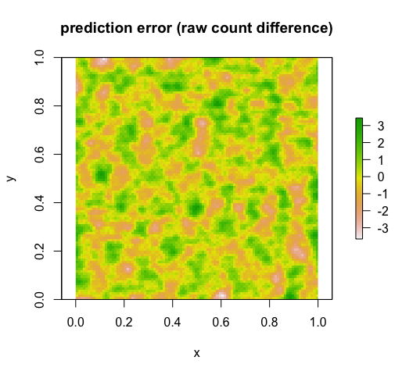
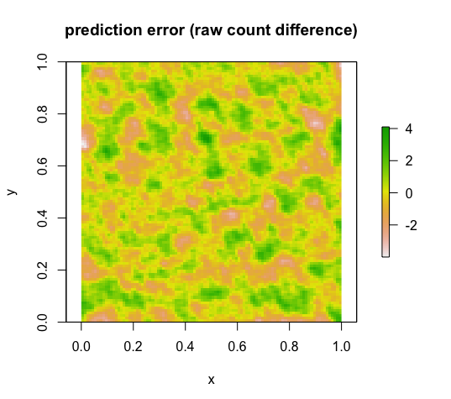
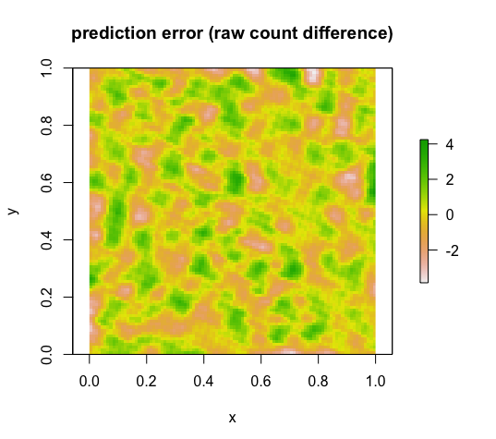
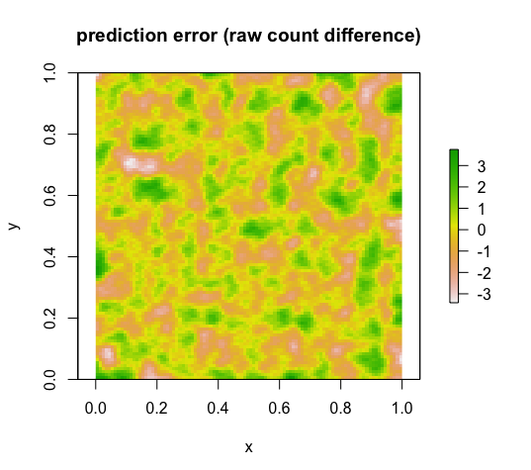
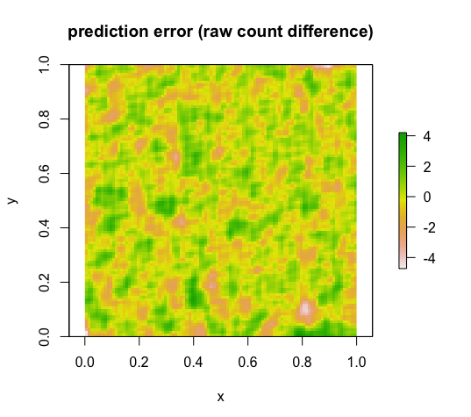
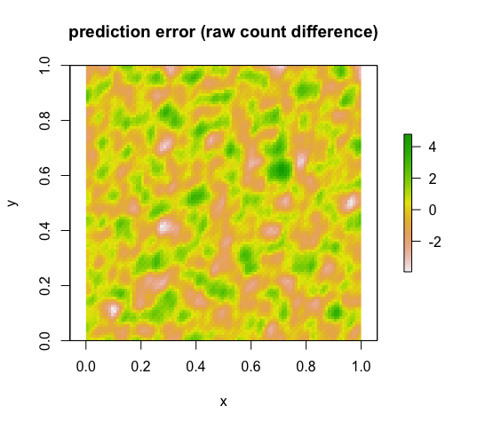
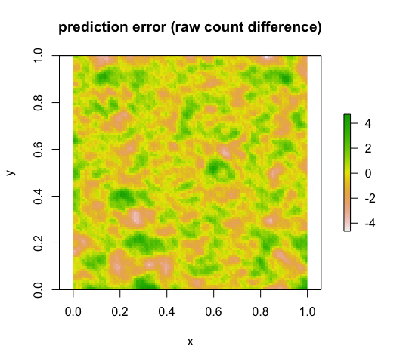
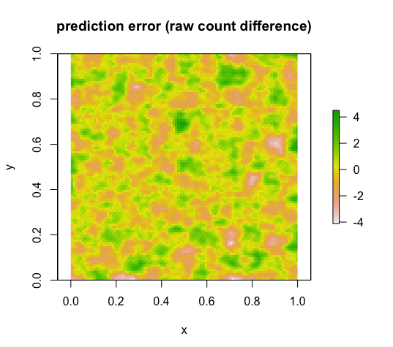
Prediction error (raw count difference)
(a)
(b)
(c)
(d)
(e)
(f)
(g)
(h)
(i)
(j)

Slide 29
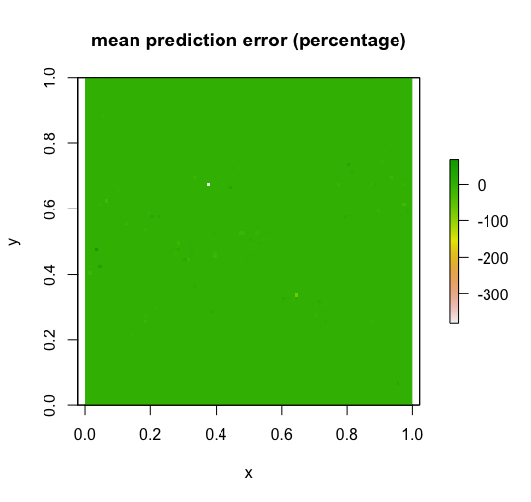
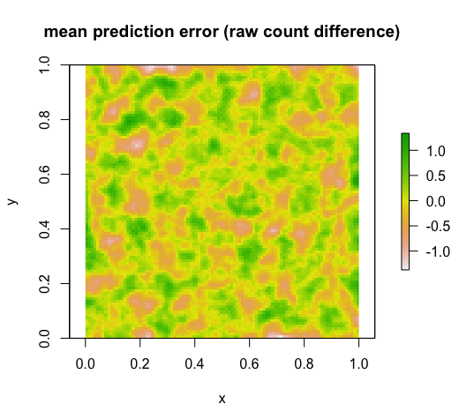
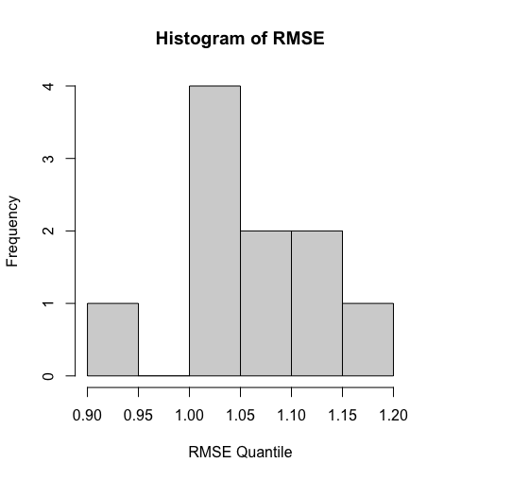
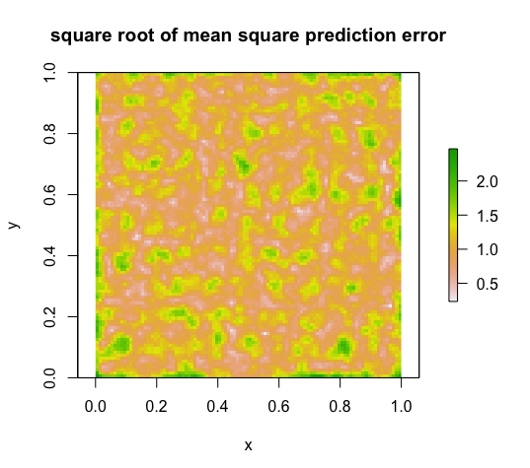
Mean Prediction Error (10 realizations)
(a)
Mean prediction
Error (percentage): -2.42%
(c)
Mean prediction Error
(raw count): 0.014
(b)
(d)
Mean square root of
mean square prediction
error: 1.02
Mean RMSE: 1.06

Slide 30
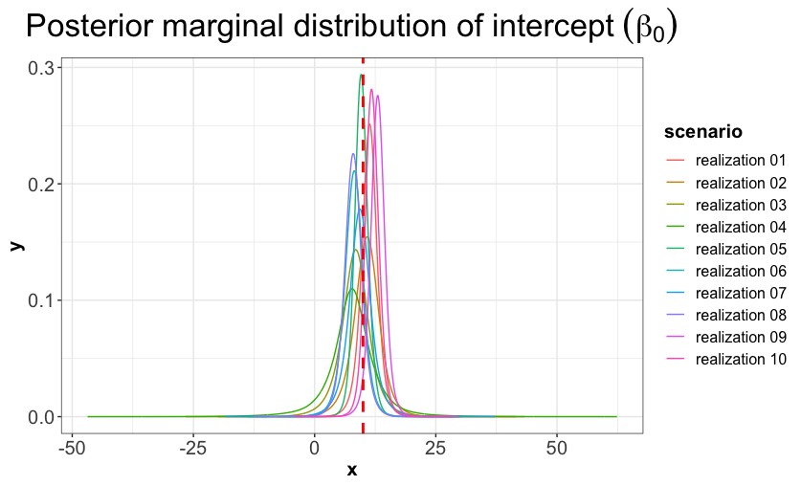
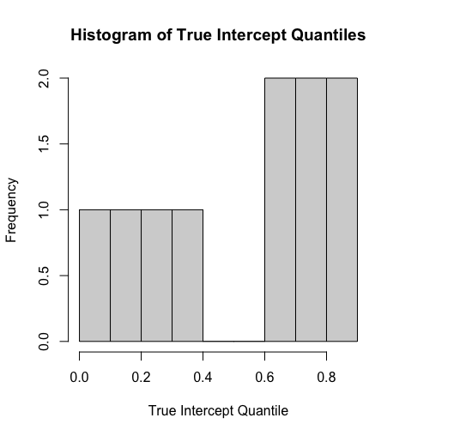
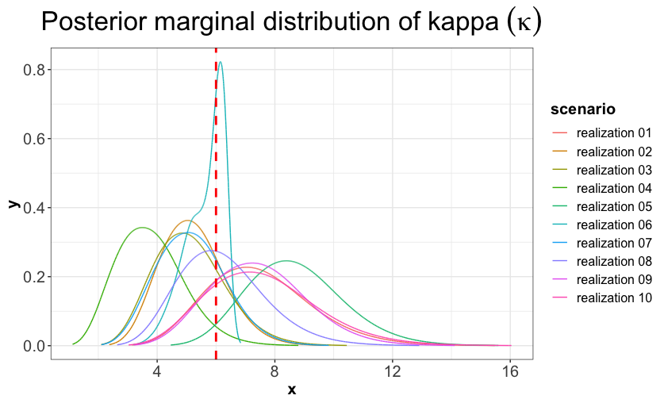
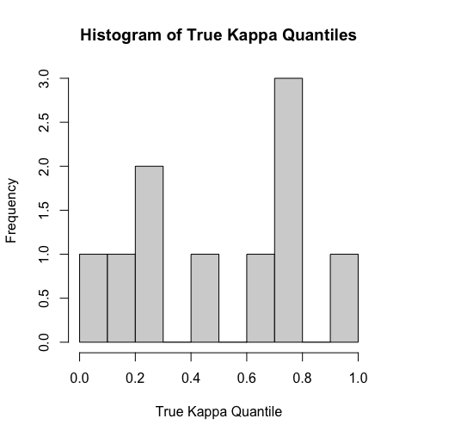
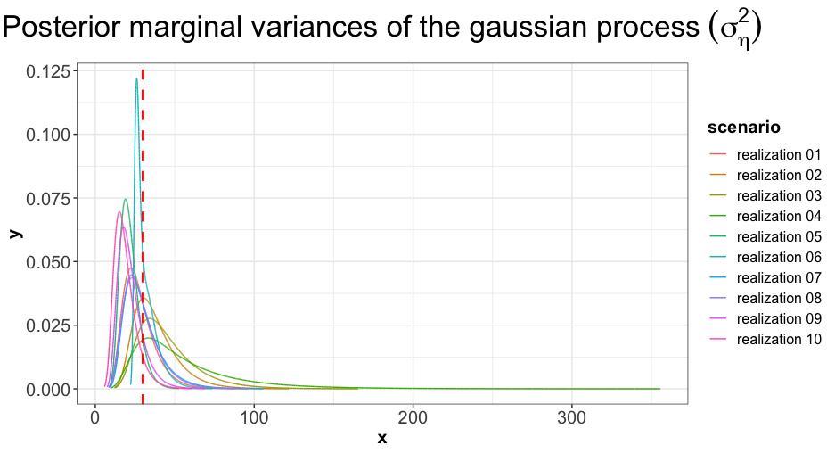
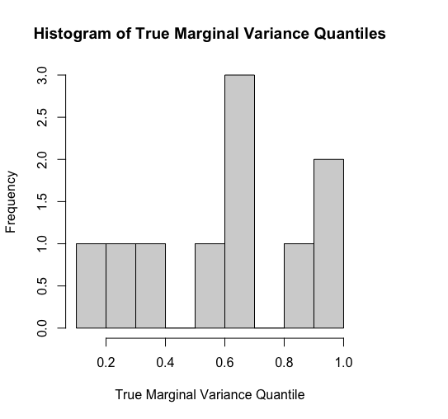
Model Parameter Estimation Comparison (10 realizations)
(a)
(b)
(c)

Slide 31
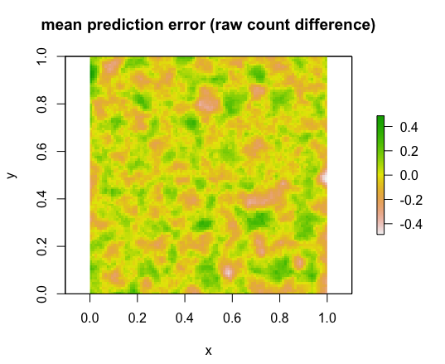
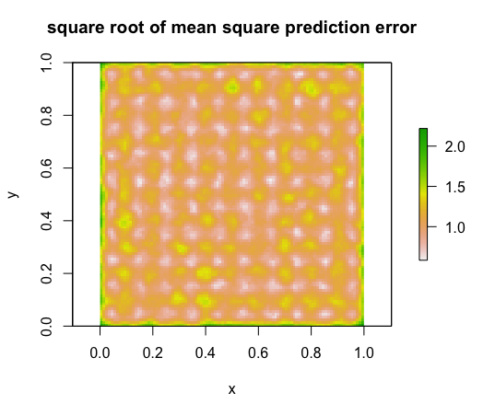
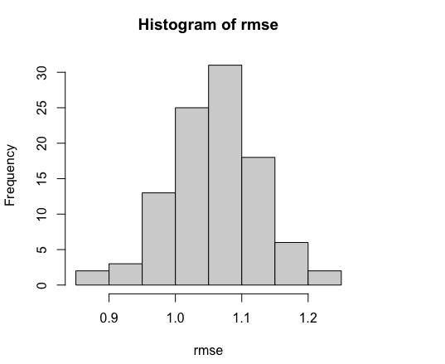
Mean Prediction Error (100 realizations)-Experiment #1
Mean prediction Error
(raw count): -0.002
Mean square root of
mean square prediction
error: 1.05
(a)
(b)
(c)
Mean RMSE: 1.06

Slide 32
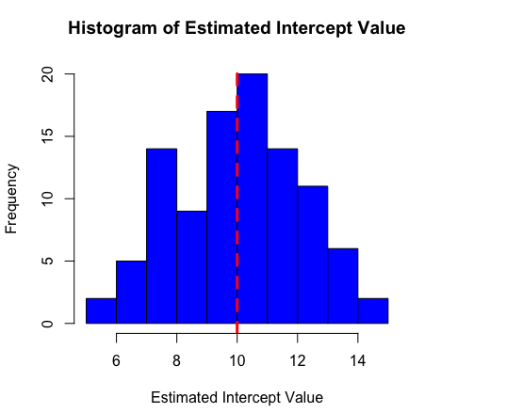
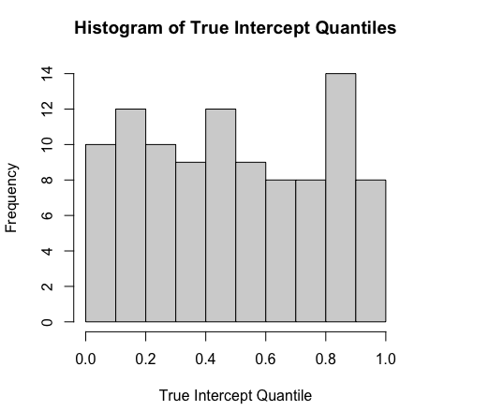
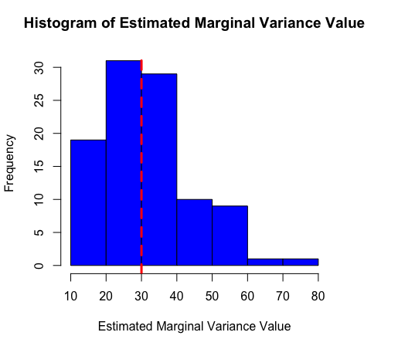
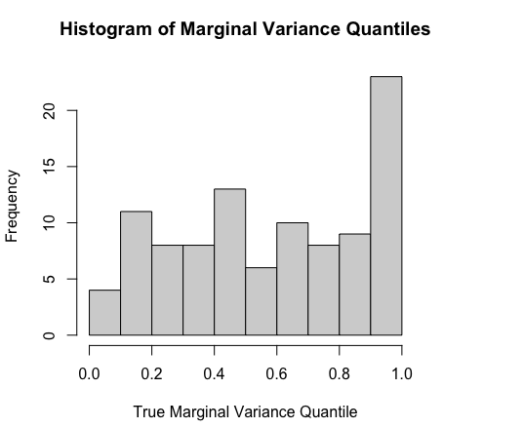
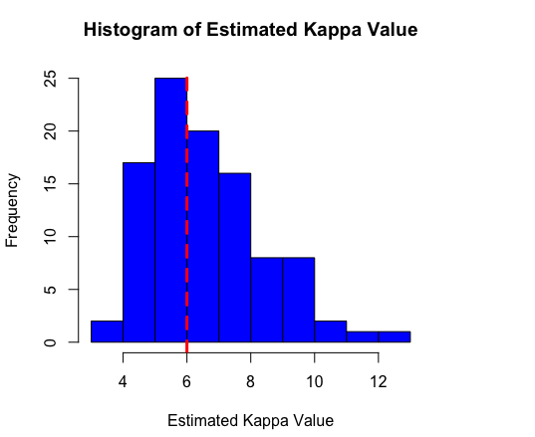
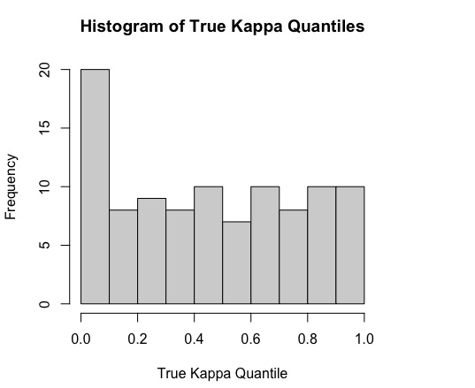
Model Parameter Estimation Comparison (100 realizations)-Experiment #1
(a)
(b)
(c)

Slide 33




Mean Prediction Error (100 realizations)-Experiment #2
(a)
(b)
(c)
(d)

Slide 34









Model Parameter Estimation Comparison (100 realizations)-Experiment #2
(a)
(b)
(c)

Slide 35




Mean Prediction Error (100 realizations)-Experiment #3
(a)
(b)
(c)
(d)

Slide 36












Model Parameter Estimation Comparison (100 realizations)-Experiment #3
(a)
Intercept
(b)
Marginal Variance
(c)
Kappa

Slide 37

Poisson Spatial Regression Model Simulation
$Y_{i} \sim Poisson(λ_{i})$, $i=1,…,n_{A},n_{A}+1,…,n_{A}+n_{p}$
$λ_{i}\left(η\right)=Eexp\left(η\right)$, $i=1,…,n_{p}$
$η=β_{0}+GP(S_{i})$, $i=1,…,n_{p}$
$GP\left(.\right)\sim N(0, Σ)$, $Σ$ is assumed to follow the Matérn class of covariance function such that for generic grid points $s_{i}$ and $s_{j}∈ℝ^{2}$, $Σ_{ij}=Cov\left(GP\left(s_{i}\right), GP\left(s_{j}\right)\right)= \frac{σ_{η}^{2}}{2^{ν−1}Γ\left(ν\right)}{\left(κ\left\|s_{i} − s_{j}\right\|\right)}^{ν}K_{ν}(κ\left\|s_{i} − s_{j}\right\|)$ , $σ_{η}^{2}$ is the marginal variance of the process, $κ$ is the scaling parameter, $K_{ν}$ is the modified Bessel function of the second kind, $ν$ is the smoothness parameter which is usually set at 1, $Α_{j}$ is the area of the tract j.
$β_{0}$ = 2
$ν$ = 1
$σ_{η}^{2}$ = 1
$κ$ = 6
Grid data is simulated on a [0,1] square area with a 0.0001m resolution, and observation data is averaged with a 0.01m resolution.

Slide 38










10 realizations visualization (#1 - #5)-Experiment 1
(a)
(b)
(c)
(d)
(e)
(a.1)
(b.1)
(c.1)
(d.1)
(e.1)

Slide 39










10 realizations visualization (#6 - #10)-Experiment 1
(f)
(g)
(h)
(i)
(j)
(f.1)
(g.1)
(h.1)
(i.1)
(j.1)

Slide 40










10 realizations visualization (#1 - #5)-Experiment 2 (before scaling)
(a)
(b)
(c)
(d)
(e)
(a.1)
(b.1)
(c.1)
(d.1)
(e.1)

Slide 41










10 realizations visualization (#6 - #10)-Experiment 2 (before scaling)
(f)
(g)
(h)
(i)
(j)
(f.1)
(g.1)
(h.1)
(i.1)
(j.1)

Slide 42










10 realizations visualization (#1 - #5)-Experiment 2 (after scaling)
(a)
(b)
(c)
(d)
(e)
(a.1)
(b.1)
(c.1)
(d.1)
(e.1)
RMSE: 6.51
R2: 0.90
MAE: 3.99
RMSE: 5.06
R2: 0.81
MAE: 3.59
RMSE: 3.95
R2: 0.85
MAE: 2.63
RMSE: 5.04
R2: 0.91
MAE: 2.94
RMSE: 5.01
R2: 0.83
MAE: 3.33
(a.2)
(b.2)
(c.2)
(d.2)
(e.2)
RMSE: 8.48
R2: 0.83
MAE: 5.21
RMSE: 5.66
R2: 0.77
MAE: 4.00
RMSE: 4.58
R2: 0.80
MAE: 2.89
RMSE: 6.9
R2: 0.83
MAE: 3.60
RMSE: 5.81
R2: 0.78
MAE: 3.79

Slide 43










(a)
(b)
(c)
(d)
(e)
(a.1)
(b.1)
(c.1)
(d.1)
(e.1)
(a.2)
(b.2)
(c.2)
(d.2)
(e.2)

Slide 44










10 realizations visualization (#6 - #10)-Experiment 2 (after scaling)
(f)
(g)
(h)
(i)
(j)
(f.1)
(g.1)
(h.1)
(i.1)
(j.1)
RMSE: 3.29
R2: 0.75
MAE: 2.31
RMSE: 4.10
R2: 0.82
MAE: 2.78
RMSE: 4.16
R2: 0.80
MAE: 2.94
RMSE: 4.87
R2: 0.79
MAE: 3.34
RMSE: 5.31
R2: 0.86
MAE: 3.50
(f.2)
(g.2)
(h.2)
(i.2)
(j.2)
RMSE: 3.70
R2: 0.68
MAE: 2.56
RMSE: 4.90
R2: 0.74
MAE: 3.16
RMSE: 4.93
R2: 0.73
MAE: 3.40
RMSE: 5.53
R2: 0.73
MAE: 3.73
RMSE: 6.65
R2: 0.78
MAE: 4.15

Slide 45










(f)
(g)
(h)
(i)
(j)
(f.1)
(g.1)
(h.1)
(i.1)
(j.1)
(f.2)
(g.2)
(h.2)
(i.2)
(j.2)

Slide 46




Poisson Spatial Regression Mean Prediction Error (100 realizations)-Experiment 1
(a)
(b)
(c)
(d)

Slide 47




Poisson Spatial Regression Mean Prediction Error (100 realizations)-Experiment 2
(a)
(b)
(c)
(d)

Slide 48






Poisson Spatial Regression Model Parameter Estimation Comparison (100 realizations)-Experiment 1
(a)
(b)
(c)

Slide 49












Poisson Spatial Regression Model Parameter Estimation Comparison (100 realizations)-Experiment 2
(a)
(b)
(c)
Intercept
Marginal Variance
Kappa

Slide 50


Model Parameters Correlation Plot

Slide 51



Microergodic parameter
MAE: 29.55
MAE: 20.90
MAE: 11.27

Slide 52

Microergodic parameter

Slide 53

Microergodic parameter
Literature review (Zhang, 2004):
For the Matérn covariogram model, only microergodic $θ= σ^{2}κ^{2ν}$ can have infill asymptotic consistent estimators.
Moreover, the spatial interpolations for unobserved locations under the same microergodic parameter tend to agree under the infill asymptotic condition.
Thus, only the microergodic parameter $θ= σ^{2}κ^{2ν}$ controls the spatial interpolation process under the infill asymptotic condition, not the parameter set $θ=(σ, κ)$

Slide 54

Hierarchical two-level poisson spatial model
$Y_{i} \sim Poisson(λ_{i})$, $i=1,…,n_{A},n_{A}+1,…,n_{A}+n_{p}$
$λ_{i}\left(η\right)=Eexp\left(η\right)$, $i=1,…,n_{p}$
$η=β_{0}+GP\left(S_{i}\right)+ φ_{𝒜_{j}}$, $i=1,…,n_{p}, j=1,…,n_{A}$
$GP\left(.\right)\sim N(0, Σ)$, $Σ$ is assumed to follow the Matérn class of covariance function such that for generic grid points $s_{i}$ and $s_{j}∈ℝ^{2}$, $Σ_{ij}=Cov\left(GP\left(s_{i}\right), GP\left(s_{j}\right)\right)= \frac{σ_{η}^{2}}{2^{ν−1}Γ\left(ν\right)}{\left(κ\left\|s_{i} − s_{j}\right\|\right)}^{ν}K_{ν}(κ\left\|s_{i} − s_{j}\right\|)$ , $σ_{η}^{2}$ is the marginal variance of the process, $κ$ is the scaling parameter, $K_{ν}$ is the modified Bessel function of the second kind, $ν$ is the smoothness parameter which is usually set at 1, $Α_{j}$ is the area of the tract j.
$φ_{𝒜_{j}}=(φ_{1,…,}φ_{n_{A}})$ capture areal spatial autocorrelation effect and are assigned a conditional autoregressive (CAR) prior, is given as $φ \sim N(0, σ_{φ}^{2}Q^{−1}(W))$, where ${Q(∙)}_{n_{𝒜}×n_{𝒜}}$ is a precision matrix and $σ_{φ}^{2}$ is the marginal variance parameter of the gaussian process. Specifically, $Q\left(W\right)= ρ\left(diag\left(W1\right)−W\right)+(1− ρ)I_{n_{𝒜}}$, where $ρ$ is a spatial autocorrelation parameter,
Grid level Matérn model parameters
$β_{0}$ = 2
$ν$ = 1
$σ_{η}^{2}$ = 1
$κ$ = 6
Areal level CAR model parameters
$ρ$ = 0.7
$σ_{φ}^{2}$ =0.25
Grid data is simulated on a [0,1] square area with a 0.0001m resolution, and observation data is averaged with a 0.01m resolution.

Slide 55




Hierarchical Poisson Spatial Regression Mean Prediction Error (100 realizations)
(a)
(b)
(c)
(d)

Slide 56












Hierarchical Poisson Spatial Regression Model Parameter Estimation Comparison (100 realizations)
(a)
(b)
(c)
Intercept
Marginal Variance
Kappa

Slide 57

Microergodic parameter

Slide 58















10 realizations visualization (#1 - #5) (after scaling)
RMSE: 3.87
R2: 0.79
MAE: 2.72
RMSE: 4.41
R2: 0.73
MAE: 3.01
RMSE: 8.75
R2: 0.90
MAE: 5.00
RMSE: 10.98
R2: 0.84
MAE: 6.01
RMSE: 5.35
R2: 0.82
MAE: 3.71
RMSE: 6.01
R2: 0.77
MAE: 4.13

